Slide 1


CREDIT SCORE FORECASTIG

Slide 2
Overview
What is credit score?
Credit score is a numerical rating that measures a person's likelihood to repay a debt.
A higher credit score indicates that a loan is lower risk and more likely to make on-time payments.
The data set contains a set of features that include an important set of information that has a direct impact on the credit score, and others that have no impact.
- Credit score is classified into three grades:
Good
Standard
poor

Slide 3
Problem Definition
credit score determines whether you will be approved for a loan and what interest rate you will pay. Prospective employers also check it to see whether you're a reliable person. Service providers and utility companies may check it to decide whether you have to make a deposit.
credit rating and risk assessment tools are used to minimize potential risk up to some extent for credit score.
The challenge here is to identify insights on the performance of a finance industry by using machine learning algorithms as they directly affect the viability of that industry.

Slide 4
Our Target
It is to classify clients based on their credit score to decide whether to accept their request of a loan or not.
And our goal will be to increase the accuracy of the credit score and reduce the risk for lenders.
the shape of our data set is (100,000 Row & 28 Feature )
We worked on two notebook the first one for development and the second for deployment

Slide 5
Problem Structuring
Data cleaning :
we checked of our dataset and it was empty of any missing value.
But we removed some unwanted record that will misleading and affects on the model.
feature engineering :
choose the most important feature in dataset and removed unnecessary
Feature like :( ID , ID_Customer , Names , SSN )
And encoding any feature nominal to numeric to let all feature is numeric

Slide 6
Problem Structuring
Outliers :
we extract the outliers of (annual_Income) and handling it by dropped it to imporve the fitting of model and give more accuracy.
Encoding categorical feature :
We encoded this five feature ('Credit_Score','Payment_Behaviour','Payment_of_Min_Amount','Credit_Mix','Occupation’) by Label Encoder, and we took into account that we used the best encoding method.

Slide 7
Problem Structuring
training and testing :
The main difference between training data and testing data is that training data is the subset of original data that is used to train the machine learning model, whereas testing data is used to check the accuracy of the model.
Also we use train_test_split class to split the data set with indicate our target.
The training dataset is generally larger in size compared to the testing dataset.
Our dataset is divided into 60% training and 40% testing with an (RFC) model.
We chose this percentage of train and test to reduce of overfitting.

Slide 8
Problem Structuring
choosing model :
we choosing random forest classifier to moduling our dataset and give us the most accuracy and select the parameter by GridSearchCV
RandomForestClassifier(n_estimators=75,max_depth=14,min_samples_split=10,random_state=1)
The random forest importance (RFI) method is a filter feature selection method that uses the total decrease in node impurities from splitting on a particular feature as averaged over all decision trees in the ensemble.

Slide 9
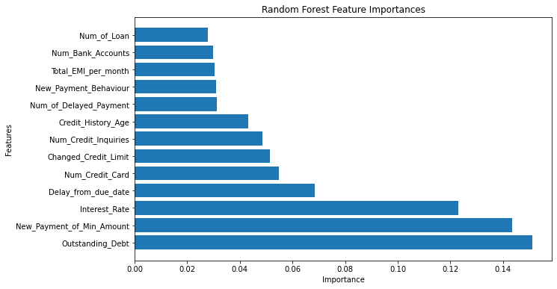
Important features

Slide 10
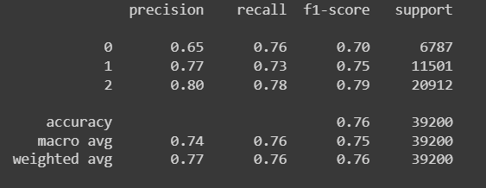
Model Accuracy
That’s the important measure we need to judge on our module.
And we also used cross_val_score to measure the efficiency of model and the result was = 0.80 .
Finally we used oversampling and undersampling by SMOTE and MISSNEAR to remove the overfitting but it was not efficient result.

Slide 11
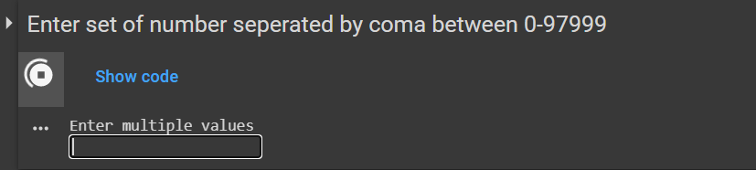
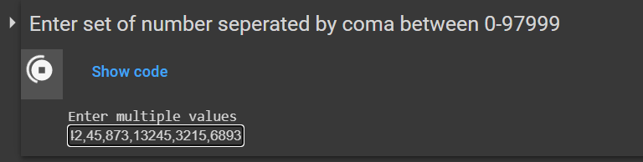
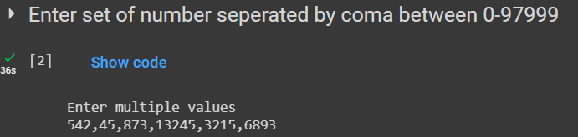
Deployment section
Here in this box we should to input the number of row we want to predict from dataset Separate between them with coma.

Slide 12
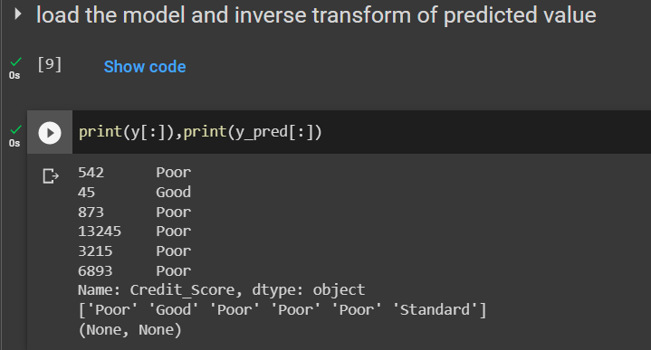
Deployment section
Here we show the result of predicting value and the actual value and we can compare to see if our predict true or false.

Slide 13
Summary
Define Credit Score and their ratings and how to make it more accurate.
determine the most important factors on which credit score based on.
analyze our dataset and convert it to information and extract the relation between the features .
Assuming hypotheses effects on credit score and prove it or denial.

Slide 14
The End
Thanks for your attention
Implement by :
- Mohammad abu al-inani
- Baker al-mohtaseb
- Hala bgoor

